Slide 1
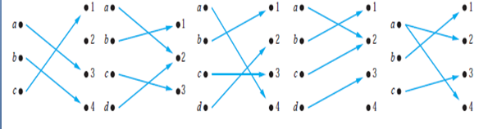
Find the properties of the following functions and describe each. (Marks-5) Time-5 min
(1) (2) (3) (4) (5)

Slide 2
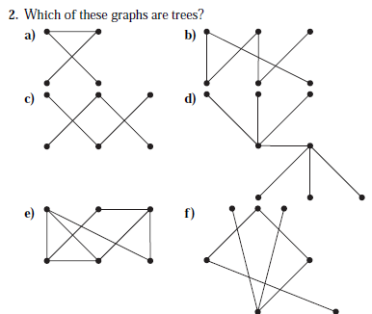
Which of these graphs are trees?(marks 3)(min5)

Slide 3
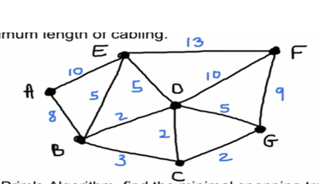
Find minimum spanning tree using this graph.Marks-3 (Min-10)

Slide 4
Express the statements.(Marks-4) (Min-10)
a) No large birds live on honey.
b) Birds of dull colors are large birds.
c) Hummingbirds are not large birds.
d) Hummingbirds are small.
Let P(x), Q(x), R(x), and S(x) be the statements “x is a hummingbird,” “x is large,” “x lives on honey,” and “x is richly colored,” respectively. Assuming that the domain consists of all birds, express the statements in the argument using quantifiers and P(x), Q(x), R(x), and S(x).

Slide 5
If A = {10,{ { 5,a,b}, ø},{ø }}, state whether the following statements are true or not. Give your reasons in each case.
{{a, b},{ } } ϵ A
{a,5,ø } ϵ A
{10,{ø }} ⊆ A
{ } ⊆ A

Slide 6
. Draw the function f from {a, b, c, d} to {1, 2, 3, 4, 5} with f (a) = 4, f (b) = 5, f (c) = 1, and f (d) = 5 and determine the function type.

